Slide 1


HAPPY MONEY- INTERN CASE
Love, Trust & Hustle

Slide 2






About Me
Anirudha Balkrishna
- I am a data science enthusiast with the domain knowledge of Finance, Analytics & Technology
Chicago, Illinois - 60607 • abalkr2@uic.edu • (312) 900 5619 • LinkedIn • Tableau • GitHub
Education
UNIVERSITY OF ILLINOIS CHICAGO (2021 – 2023)
MS, Business Analytics
Graduate Teaching Assistant – Information & Decision Sciences (Jan 2022 – May 2022)
NMIMS UNIVERSITY, MUMBAI (2014 – 2019)
MBA, Technology management (Specialized in Finance & Analytics)
Bachelor’s in Technology (Specialized in EXTC)
Work Experience
SVAKARMA FINANCE (Jun 2019 – Jun 2021)
As an Analyst in the product team, I was responsible for data analysis, research, pseudo-credit underwriting and managing products. The primary objective of the product team was to maintain and remodel the master lending policy (used to define the credit policy of a Financial Institution). The policy was updated based on research of various segments and by analysing internal borrower data (& data from credit bureaus). Additionally, creating and managing debt products for niche sector clients in the form of business correspondent arrangements were tasks undertaken by me as a part of the product team.
DUN & BRADSTREET (May 2018 – Sep 2018)
My project at the D&B, Project Appraisal Services was to ascertain risk related to different projects (green field & expansion). The assessment is done by calculating financial risk (using financial models) and evaluating projects based on market research and technical analysis. I assisted team members in the making of such Techno- economic viability reports.
RELIANCE JIO (May 2017 – July 2017)
The main aim of the project was to analyse various Optical networks to assist in the commissioning of new optical-fibre routes and to decommission leased lines. The data for optical networks was analysed by obtaining logical inventory details using GI systems.

Slide 3
Outline
This presentation is divided into three sections based on the case. These sections are -
Understanding Product & Customer - In this section, I have briefly explained the working of credit scores and then answered the questions from the case in slides 6 & 7.
Credit Risk - In this section, I have used data science concepts to answer the questions. I have used python as the programming language and Google- Colab as the notebook editor. I have also attached the Code & the Jupyter notebook output for your reference.
Business Model – This section explains the business model & factors that impact profitability.
Double Click to Open & View
Code -
PDF Output -

Slide 4
Understanding Product and Customer
1
Happy Money’s personal loan product Payoff is an unsecured instalment loan designed to help people refinance their credit card debt. People who use Payoff loans to pay down their credit card debt usually gain significant interest savings and see their FICO score increase by ~30 points.

Slide 5

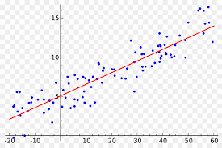


Understanding Product and Customer
Why do FICO scores increase after customers avail a payoff loan ?
Let us first understand, How credit scores are calculated -
Credit bureau companies collect information from Banks, Financial institutions, Credit card companies etc. regarding their customer’s repayments.
The data includes various factors like number of loan obligations, credit utilization, past performance, delinquencies etc.
This data is filtered, cleaned & labelled.
Next, this pre-processed data is passed through a statistical model (machine learning system). The model goes through all the data and creates a function to assign a score for an applicant. (Typically, a Random Forest or Gradient Boosted model is used for this statistical computation).
Therefore, when a customer applies for a loan, the applicant’s credit score is obtained based on their credit history using the function
From a lender’s perspective, an ideal borrower is an applicant that has
never defaulted on a payment
not taken more credit than they can repay
not been desperate for credit (fewer enquiries)
not utilized their entire credit limit
As a borrower approaches this ideal profile, they are rewarded with an increase in credit score. (& vice versa)
No. of loans – 20%
Delinquency – 60%
Others – 20%
Data
Model
Function

Slide 6
Understanding Product and Customer
Why do FICO scores increase after customers avail a payoff loan ?
For our specific scenario -
When customers with high credit card debt consolidate their debt using a payoff personal loan, they end up making multiple changes to their credit account at the same time. These include –
Number of Obligations - When credit card debt is consolidated, the borrower reduces the number of credit obligations associated with them. This is registered as a positive change and may cause the credit score to increase.
Credit Utilization - A factor with respect to credit cards is their utilization ratio. When credit card debt is eliminated, you basically reduce the utilization. This also causes an increase in the credit score.
Changes to Credit Mix - When an applicant avails a payoff loan, they essentially avail a personal loan. This may be a new type of loan that the customer has availed. This adds to the credit mix of a customer. From a lender’s perspective, the borrower is gaining experience in handling a new type of loan obligation and therefore, seems as a responsible debtor.
Timely Payments - Once the payoff loan is availed and monthly instalments are honoured, the customer approaches the ideal profile of a borrower and therefore will see an increase in the credit score

Slide 7
Understanding Product and Customer
Major reasons for people to default on their Payoff personal loan
In general, there are 2 broad reasons that cause borrowers to default on their loans –
Ability – The refers to the financial ability of a borrower to repay
A borrower may be Over - Leveraged. For instance, if a borrower has a monthly loan obligation of $100 but, he earns only $75, then he may not be able to pay the loan even if he intends to pay. (This would typically happen if a borrower seeks additional funding after receiving the payoff loan)
In case a borrower’s income stream is not aligned with the loan due dates, the borrower may default.
For instance -
The borrower may have encountered an unforeseen circumstance like a road accident. This may cause them to skip on loan repayments in order to tend to the circumstance.
Intent - This refers to the willingness of a borrower to repay.
It is a very undesirable scenario as a lender, if the borrower does not intend to honour their obligation. (For instance – Businessman Vijay Mallya defaulting on his business loans)
Week | Before consolidation |  | After consolidation
 | Income | Obligation | Income | Obligation
Week 1 | Job 1 - $1000 |  | Job 1 - $1000
Week 2 |  | Credit Card 1 - $ 700 |  | Consolidated Loan - $ 1400
Week 3 | Job 2 - $1000 |  | Job 2 - $1000
Week 4 |  | Credit Card 2 - $ 700

Slide 8
Credit Risk
2
In the Risk Dataset, you have a list of application stage attributes and the final credit performance result of past applicants. The “bad flag” represents the list of customers who defaulted on our loan.

Slide 9
Credit Risk
Dataset Details –
The data has 95633 rows with 6 features or independent variables & 1 target or dependent variable
The independent variables are numeric (integer & float)
There are no missing values
There are 51 instances of negative credit card balances. (This is possible if the card holder was rewarded or refunded)
The dependent variable is a binary classification that tells us if a payoff loan applicant defaulted
Out of the 95633 data points, 84820 are non-defaulters whereas the remaining 10813 are defaulters
Approach –
In order to understand which score better separates the applicants and also to know their effect on prediction, one can compute Variable importance (feature importance)
Feature importance can be calculated using Correlation coefficients (for continuous variables), stepwise selection, using models like regression, decision trees, random forests, extreme gradient boosting, k-nn etc.
I have used 2 models – A decision tree & a random forest model to assess feature importance

Slide 10
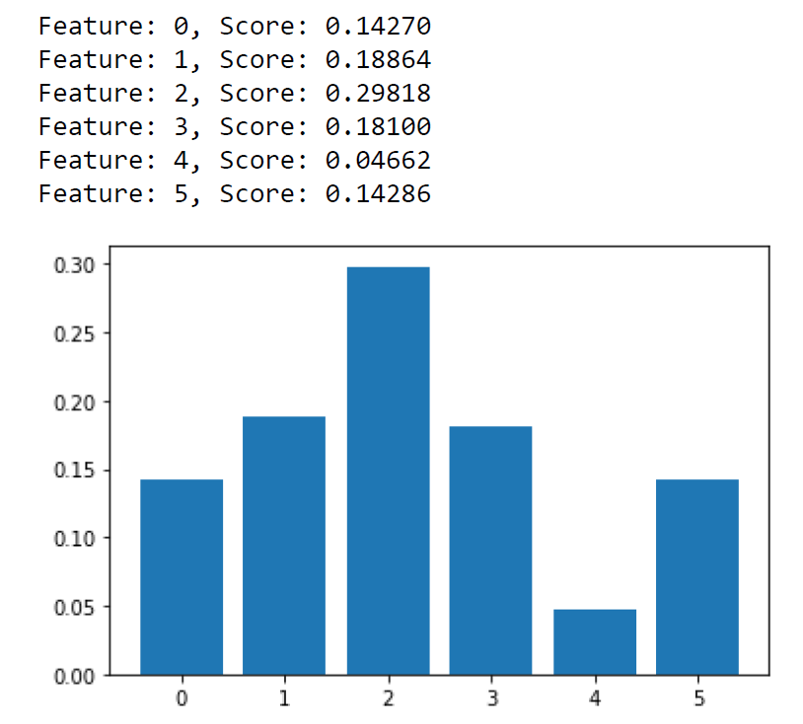
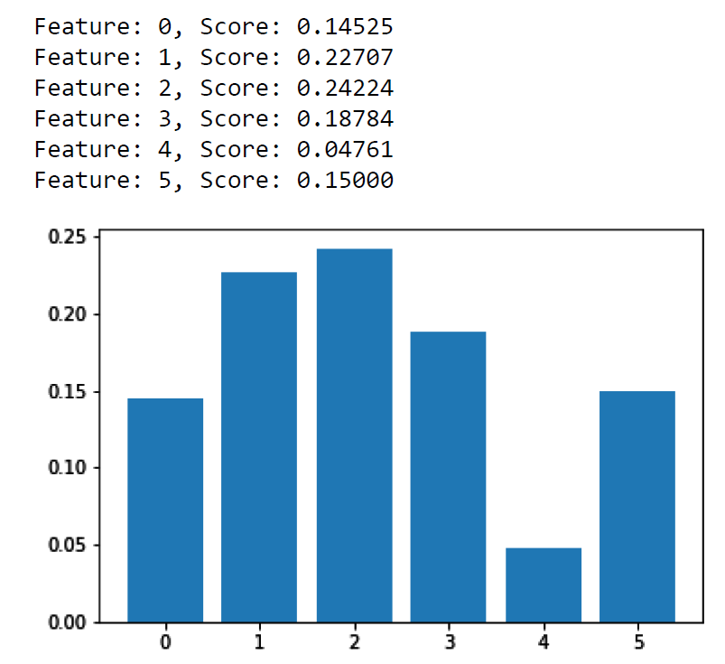
Credit Risk
Decision Tree Model –
As evident from the bar graph showing the importance of features, Feature 2 or Custom Score 2 has the highest importance.
This means that amongst the available features, Custom Score 2 is most responsible for predicting the output class
Similarly, Feature 4 or Inquiries Last Month least explains the output class
The scores calculated by the model are also mentioned above the graph
Random Forest Model –
The random forest model gives a result similar to the decision tree model
But, the underlying importance scores are different
Here again, Feature 2 or Custom Score 2 has the highest importance.
But, Feature 1 or Custom score 1 is not far behind

Slide 11
Credit Risk
Of the different model scores (FICO, Score1, Score2) which one does a better job of separating good accounts and bad accounts ?
Based on the importance scores and plots obtained from the Decision Tree & Random Forest Models, Score 2 does the best job of separating the defaulters & non defaulters.
Score 1 is the next best feature
The FICO score is last amongst the 3 scores
Are “CreditCardBalance” and “InquiriesInLast6Months” predictive of risk in addition to the best score you identified from the last question?
The features “Credit Card Balance” & “Inquiries in last 6 months” predict risk like the scores we saw in the previous question.
But, “Credit Card Balance” is a better predictor compared to “Inquiries in last 6 months”
In fact, “Inquiries in last 6 months” is the poorest predictor among the given features
“Credit Card Balance” on the other hand performs better than the FICO score in both models & is amongst the top 3 predictors

Slide 12
Business Model
3
Happy Money is a marketplace lender that connects credit unions’ capital and borrowers.

Slide 13



Business Model
Best guess of Happy Money Payoff loan’s business model
When a borrower approaches Happy Money to Refinance their Credit Card debt, Happy Money will conduct a credit check (underwriting process) and decide if the debt can be refinanced.
If the borrower can be refinanced, Happy Money will Pay the credit card debt through capital acquired from Credit Unions (Low interest loans)
Once a Credit card debt is refinanced, the borrower does not owe any repayments to the credit card company. Instead the borrower will owe a monthly instalment to Happy Money (Payoff) & will pay an origination fee
A small share of the origination fee and interest repayment are kept by Happy money as commission
The remaining share is returned to Credit Unions
2
1
Credit card debt Refinance
Capital Released by CU
3
4
Origination Fee
Share of Origination Fee
5
6
Monthly Instalment
Share of Instalment

Slide 14
Business Model
List and explain the factors that impact the profitability of Happy Money Payoff loan program
There are many factors that impact the profitability of a program. For our specific case –
Credit Policy & Underwriting Framework
In Financial institutions, loans are disbursed based on credit policy guidelines. These guidelines decide if a borrower will qualify for financing.
If the policy is too lenient, the program will see more defaults that will eventually lower the profitability. On the other hand, if the policy is too strict, sourcing will be restricted, which will see the program lose out on potential borrowers.
Network of Credit Unions
Since the capital to refinance the credit card debt is availed from credit unions, building a network of credit unions is essential.
Based on negotiations with these credit unions, Happy Money can decide on the referral fees, interest sharing, fees sharing etc.
Loan Parameters - Interest Rates, Origination Fee & Tenure
Pricing of loan parameters like interest rate, origination fee & setting of tenure will impact profitability
Operational Costs
Operational Costs involved in setting up and scaling the business will impact profits
Outside Factors
Factors like the Monetary Policy, Fiscal Policy, Regulatory Framework etc. may also cause changes to the revenue

Slide 15
Thank you
Made by – Anirudha Balkrishna

